Slide 1
What to include in a technical rider
What does it include and how can you communicate what you need
Ask questions at any point!

Slide 2
Basic Information
Main contact/s – this could be one person or many. Helpful to identify the tour manager, if they’re not the same person advancing the show
Touring Party – roles
Show synopsis – could be your marketing copy, helps us to understand the themes and scale
Run time
Interval
Pre- and/or post-show activities (e.g., Q&As, meet and greets, merchandise, tactile tours, etc.)

Slide 3
Logistics
Flight Information – if you know where each touring party member is travelling to/from that’s great. If excess baggage is required.
Accommodation – a breakdown of how many rooms and room types. If people are sharing a room. It’s helpful here to communicate if a request is just a preference, or if it’s a must-have (i.e., a two-bedroom apartment could also be fulfilled with 2x queen hotel rooms. Or a request for an apartment with a kitchen/kitchenette is only a must-have for stays greater than 1 week, for example.)
Per diems – confirm that this is part of your request
Transport – if you know there is a lot of luggage, please be clear that a larger vehicle is required for airport transfers. Also be clear if all transfers are a must-have, or if only certain ones are (e.g., airport transfers, first and last transfer to venue) – this could be dependant on how close the accommodation is to the venue. E.g., transfers between venue and accommodation only required if walking distance is greater than XX kms / 20 minutes.

Slide 4
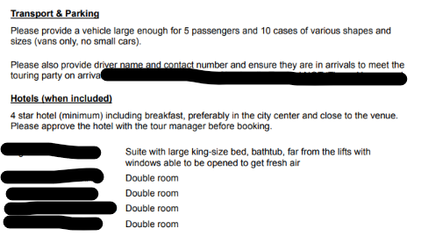
Logistics - examples

Slide 5
Technical Requirements - General
Does anyone have a production background?
Break down your requirements by department – Lighting, Sound, AV, Staging
As much information as you can provide UNLESS it’s no longer relevant to the upcoming show. For example:
  The same show was performed in the past but a key component has changed
  You’re touring a new production of an existing work
Include photos and/or links to archival recordings where possible
Be clear about what equipment you are touring and what you need the venue to supply
If you’re providing documents later, let us know when to expect them
Do you need a pre-rig?
  This can differ from venue to venue depending on what they have set-up. It helps to note “if required” to start the discussion
  Communicate clearly what your expectations are when you arrive at the venue. For example: If the touring company needs to walk in and start plotting lights straight away to be ready for the first show, then its likely you need a pre-rig but can depend on what the venue has set-up.

Slide 6
Lighting
It’s helpful to communicate the purpose/effects you are trying to achieve in your lighting plan.
You can list specific fixtures, but often venues – especially regional ones – will want to know if the effect is achievable with their in-house fixtures or if they need to consider hiring equipment, which costs money and can be limited in availability depending on location.
Provide a generic lighting plot early, and provide a venue-specific plot or communicate how it fits into the venue later down the line
Be clear about your must-haves vs your nice-to-haves.

Slide 7
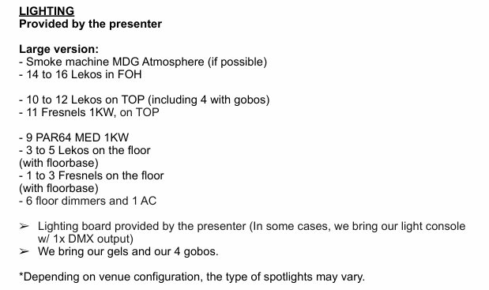
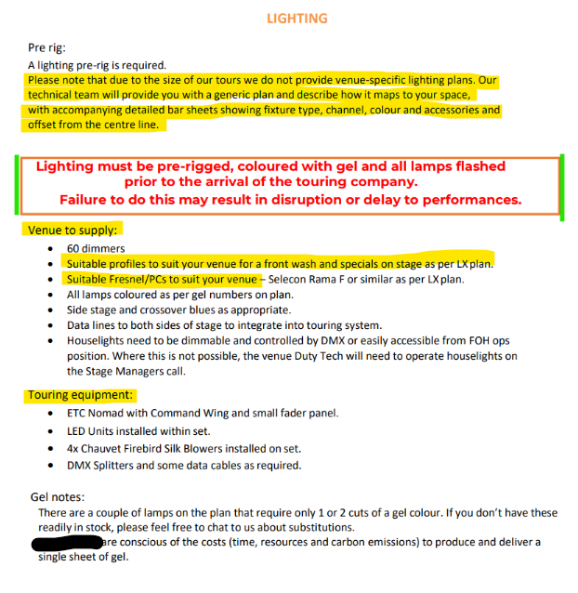
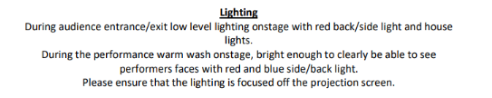
Lighting – examples

Slide 8
Sound
Unlike with lighting, it’s helpful to be more specific about your requirements.
There is more scope in Sound to negotiate, so it’s important to be clear about your must-haves and nice-to-haves, and what equipment is okay to be substituted for something similar
Provide a cue sheet if possible

Slide 9
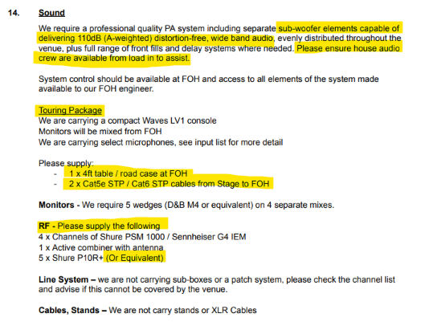
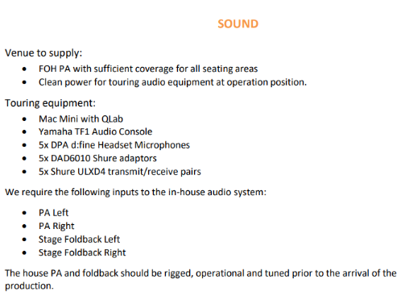
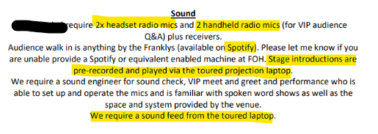
Sound - examples

Slide 10
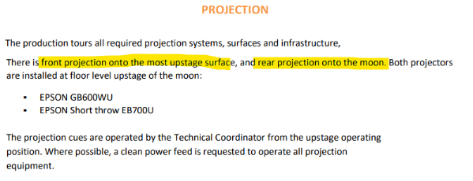
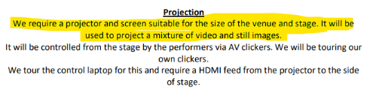
AV
Be clear about what you want to achieve with your AV / Projection
Requirements change depending on the space, so communicating the purpose / desired outcome is important
Examples:

Slide 11
Staging
Include minimum stage size required
If the show has set pieces, ensure they’re theatre-ready and communicate this. It also helps to share what is required to put it together
Provide a stage plan
Be clear about what needs to be rigged vs what requires a fly tower. Many venues don’t have a fly tower, so also communicate if this is a must-have or nice-to-have.
Photos are very helpful here!

Slide 12
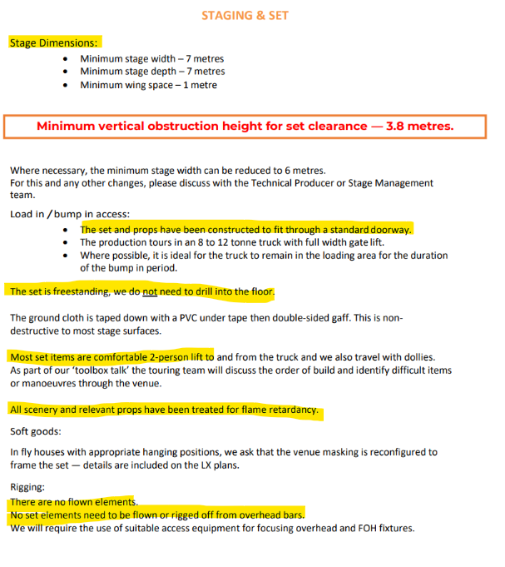
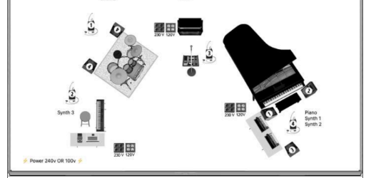
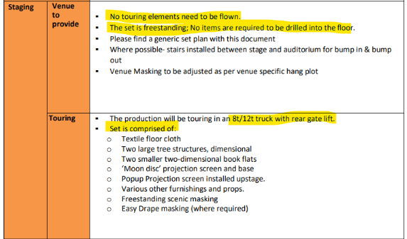
Staging - examples

Slide 13
Production Schedule
Including a production schedule is super helpful!
It can be generic and basic, but it communicates what needs to happen before the first show, and how long is needed to get there.
It also helps venues to get a realistic sense of costs and if a pre-rig is required

Slide 14
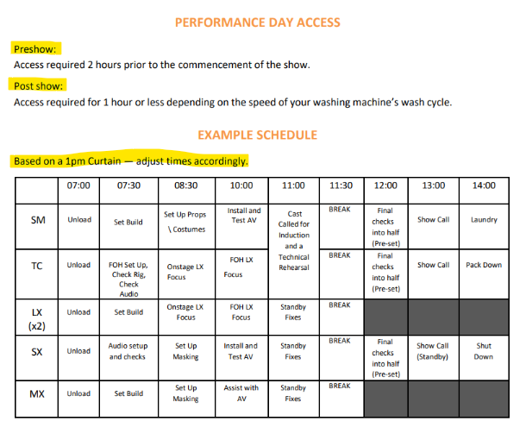
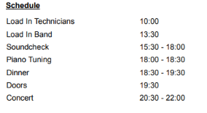
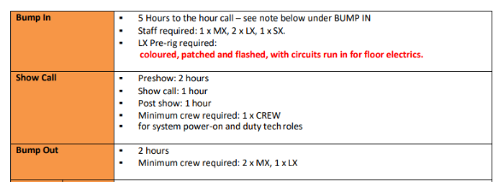
Production Schedule - examples

Slide 15
Other Production information
Venue Production Staff - communicate how many and what type/s of venue production staff you would like present during bump in, performances, and bump out. Venues may have minimum staffing requirements, but this helps to communicate what skills are required
Special Effects – let us know if there’s any haze, pyrotechnics
Risk Assessment – acknowledge that you will provide a venue-specific one closer to the performance, and when you will provide it
Freight – the size of the truck, if it needs to be parked on-site, what access requirements it has
Wardrobe – do you need access to laundry facilities, what facilities do you need, do you have someone in the touring company who looks after laundry or do you need venue staff to look after laundry

Slide 16
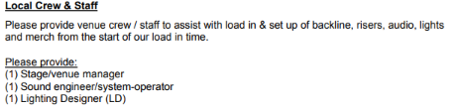
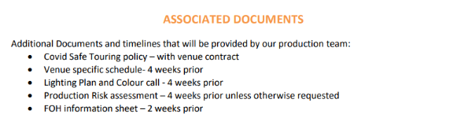
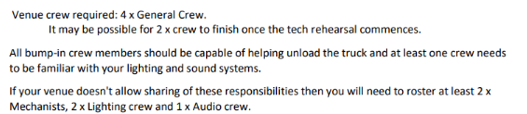
Other Production information - examples

Slide 17
Backstage Requirements & Hospitality Riders
If you have specific requests for backstage and catering – please include them.
They can be specific or generic – as always, please communicate what are the must-haves, nice-to-haves, and what can be substituted

Slide 18
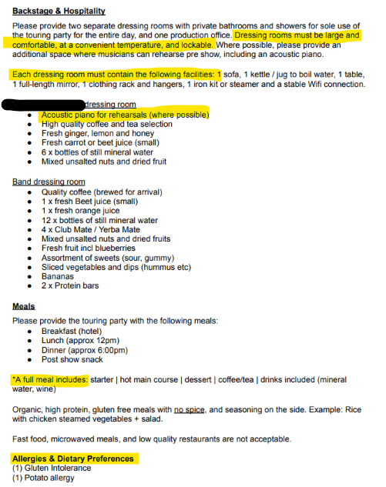
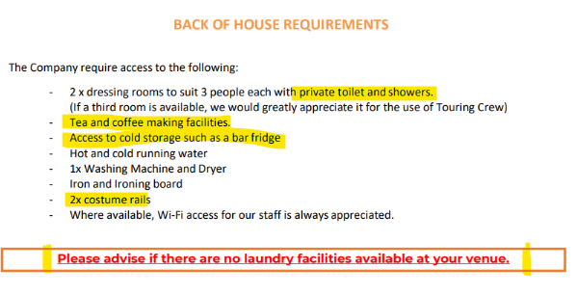
Backstage Requirements &
Hospitality Riders - examples

Slide 19
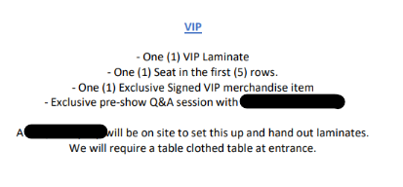

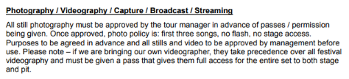
Front of House information
Photography and filming policy
Provide details about merchandise sales, meet & greets, etc., where applicable
Examples:

Slide 20
Questions!?

